Slide 1
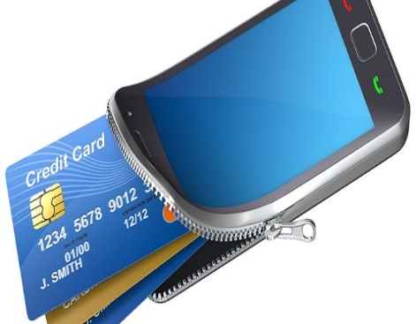
Google TEZ
Transforming the way you pay!!

Slide 2
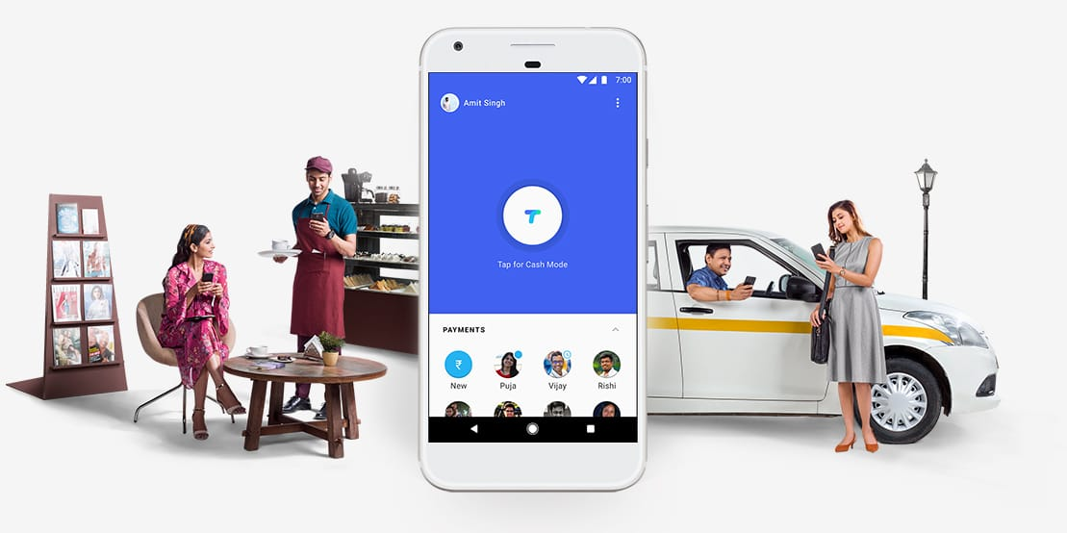
TEZ
Money Made Simple
Send money home to your family, split a dinner bill with friends, or pay the neighbourhood chaiwala. Make all payments big or small, directly from your bank account with Tez, Google’s new digital payment app for India.

Slide 3
TEZ
Money Made Simple
It is easily available for download for free at :

Slide 4
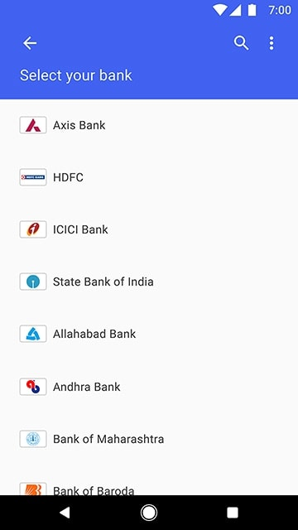
TEZ
Money Made Simple
Money in your bank
With Tez, you can pay directly from your bank account¹, which means your money is safe with your bank and you’ll continue to earn interest. There’s no need to open a separate account or worry about reloading wallets.
Supported Banks:
Tez uses UPI (Unified Payments Interface) and works with all major banks, including our partners: Axis, HDFC Bank, ICICI and State Bank of India.

Slide 5
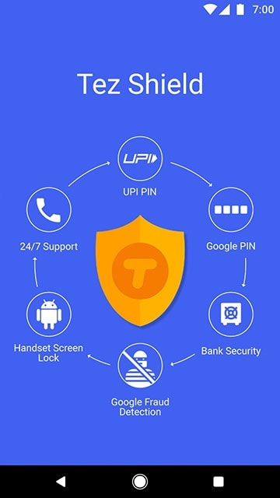
TEZ
Money Made Simple
How about TEZ’s Security!!
Secure payments with Tez Shield
The Tez Shield works 24/7 to help detect fraud, prevent hacking, and verify your identity. Each transaction is secured with your UPI PIN and the app is secured with a Google PIN or your screen lock method such as fingerprint. If you ever need help, our help centre, phone, and chat support are available all day, every day.

Slide 6
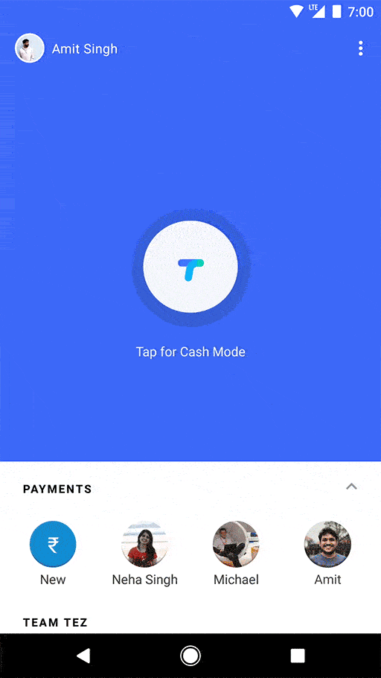
TEZ
Money Made Simple
Pay nearby
Use Cash Mode to send money instantly to another Tez user nearby without needing to share private details like your bank account or phone number. Now you can transact with the simplicity of cash, but with added security.

Slide 7
TEZ
Money Made Simple
Pay online with Tez
Tez makes it faster and more secure to pay on apps and websites – anywhere that UPI is accepted. When you check out, look for the Tez logo or use your Tez UPI ID.
Now playing online Banking is more secure and Fun!!

Slide 8
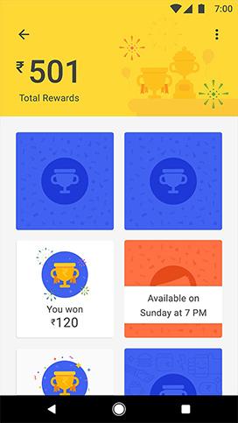
TEZ
Money Made Simple
Delightful surprises
Earn Tez Scratch CardsTM to win up to ₹1,000 with each transaction² and be eligible to win ₹1 lakh every week with Lucky Sundays. You don’t need to hunt for coupon codes. Just use Tez and if you win, your rewards go straight into your bank account.

Slide 9
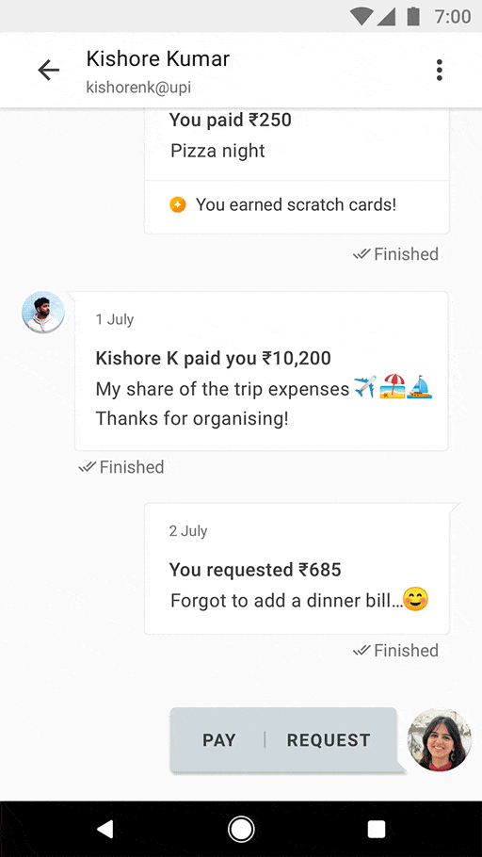
TEZ
Money Made Simple
Made for India
Tez works with all major Indian banks and the vast majority of smartphones — so you can pay or get paid by almost anyone. And with language support for English, Hindi, Bengali, Gujarati, Kannada, Marathi, Tamil, and Telugu, sending money is easy to understand.

Slide 10
TEZ
Money Made Simple
For business owners and merchants
Business owners and shops can use the Tez app with their individual current account to start accepting digital payments today. Payment goes directly to your bank account — all with no fees³. We are working to support shopkeepers with other types of current accounts soon.
If you sell online, check out Tez for B

Slide 11
Ayan Chowdhury

